Slide 1
Java Basics

Slide 2
Java was developed by Sun Microsystems in 1995.
James Gosling is known as the father of Java. Before Java, its name was Oak.
Java is a high level, robust, object-oriented and secure programming language.

Slide 3
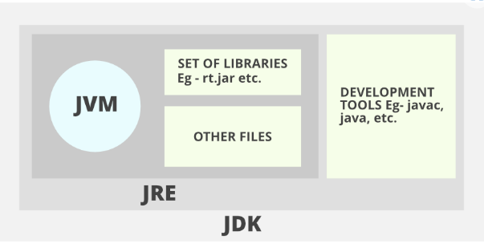
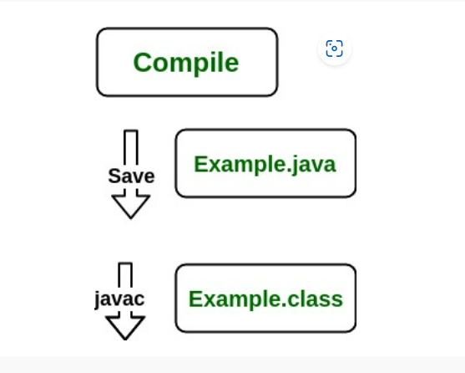
The following actions occur at runtime as listed below:
Class Loader
Byte Code Verifier
Interpreter
Execute the Byte Code
Make appropriate calls to the underlying hardware
Study difference between JRE and JDK

Slide 4
JDK (Java Development Kit) is a Kit that provides the environment to develop and execute(run) the Java program.
JDK=JRE+Developmental Tools
JRE (Java Runtime Environment) is an installation package that provides an environment to only run(not develop) the java program(or application)onto your machine. JRE is only used by those who only want to run Java programs that are end-users of your system.
JVM: Whatever Java program you run using JRE or JDK goes into JVM and JVM is responsible for executing the java program line by line, hence it is also known as an interpreter. (JVM is platform specific)

Slide 5
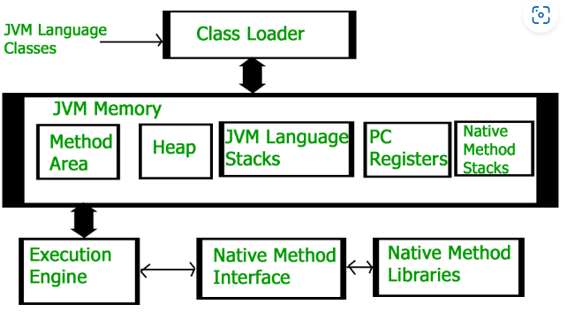
How JVM works?
JVM is the one that actually calls the main method present in a Java code.
Loading:The Class loader reads the “.class” file, generate the corresponding binary data and save it in the method area. For each “.class” file, JVM stores the following information in the method area.
The fully qualified name of the loaded class and its immediate parent class.
Whether the “.class” file is related to Class or Interface or Enum.
Modifier, Variables and Method information etc.

Slide 6
Classloader: Loads class file, reads bytecode and brings it to JVM memory. Performs loading, linking and initialization.
JVM Memory:
Method Area: Stores metadata about loaded classes, such as (fields and methods, method bytecode, runtime constant pool. Shared among all threads.
Heap: Stores objects and class instances created by the application, Garbage Collection operates here to manage memory.
JVM Language Stacks:
Each thread has its own stack, Stores method calls (stack frames) for the thread. LIFO (Last In, First Out) structure.
PC: Each thread has its own PC register, Stores the address of the next instruction, multithreading
Native Method Stacks: platform specific operations

Slide 7
Final variables
If you don't want others (or yourself) to overwrite existing values, use the final keyword (this will declare the variable as "final" or "constant", which means unchangeable and read-only):
final int myNum = 15;
myNum = 20; //this will raise an error

Slide 8
Typecasting: assigning a value of one primitive data type to another type
Widening Casting (automatically) - converting a smaller type to a larger type size
byte -> short -> char -> int -> long -> float -> double
Narrowing Casting (manually) - converting a larger type to a smaller size type
double -> float -> long -> int -> char -> short -> byte

Slide 9
Note: narrowing type casting is data loss. When going from a larger data type to a smaller one, we may lose accuracy or range.
Interview Question: How is Data loss handled in Narrow casting?

Slide 10
Types of Variables
LOCAL VARIABLE
INSTANCE VARIABLE
STATIC VARIABLE

Slide 11
Local Variable
A variable declared inside the body of the method is called local variable. You can use this variable only within that method and the other methods in the class aren't even aware that the variable exists.
A local variable cannot be defined with "static" keyword.
2) Instance Variable
A variable declared inside the class but outside the body of the method, is called an instance variable. It is not declared as static.
It is called an instance variable because its value is instance-specific and is not shared among instances.
3) Static variable
A variable that is declared as static is called a static variable. It cannot be local. You can create a single copy of the static variable and share it among all the instances of the class. Memory allocation for static variables happens only once when the class is loaded in the memory.

Slide 12
Static keyword Java
We can apply static keyword with variables, methods, blocks and nested classes.
The static keyword belongs to the class
Example: Math.sqrt(16);// sqrt is static method of Math class

Slide 13
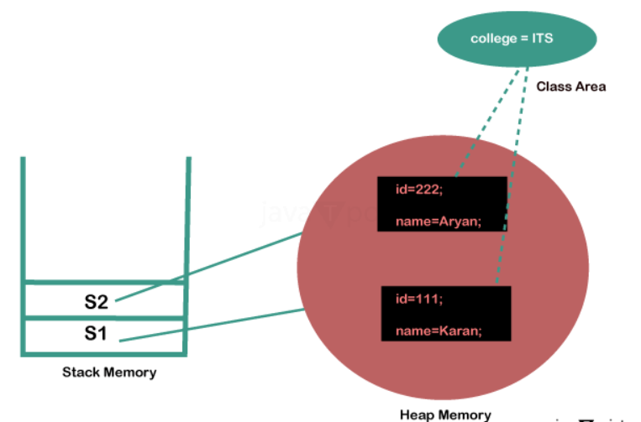

Slide 14
Why is main() static?
In Java, the main() method is declared as static because it serves as the entry point for the JVM (Java Virtual Machine) to start executing a program. Declaring it as static allows the JVM to call it without creating an instance of the class.

Slide 15
public class MainExample {
int instanceVar = 10; // Non-static variable
public void instanceMethod() {
System.out.println("Instance Method Called!");
}
public static void main(String[] args) {
// Create an object of the class
MainExample obj = new MainExample();
// Access non-static members through the object
System.out.println("Instance Variable: " + obj.instanceVar);
obj.instanceMethod();
}
}
Ques: How to Access Non-Static Variables from static main()

Slide 16
Garbage Collection

Slide 17
Garbage Collection (GC) in Java is the process of automatically reclaiming memory occupied by objects that are no longer reachable or in use.
It helps in efficient memory management and prevents memory leaks.
Java manages memory dynamically using the heap.
Objects created using new occupy memory
If objects are not explicitly removed, they can cause memory leaks
Garbage Collector (GC) automatically detects and removes unreachable objects.

Slide 18
To explicitly call java GC:
System.gc(); // Requests JVM to run GC
Runtime.getRuntime().gc(); // Alternative method
these calls do not guarantee immediate execution of GC.

Slide 19
Mark and Sweep algorithm
Mark Phase
GC identifies all reachable objects.
Objects that are not reachable are considered garbage.
(b) Sweep Phase
The memory occupied by unreachable objects is reclaimed.
(c) Compact Phase (Optional)
The heap is compacted to avoid fragmentation.

Slide 20
class Demo {
int data;
}
public class GCExample {
public static void main(String[] args) {
Demo d1 = new Demo(); // Object created
d1 = null; // Eligible for GC
System.gc(); // Request GC
}
}

Slide 21
Finalize method: Before an object is garbage collected, Java calls its finalize() method (if overridden)
class FinalizeExample {
protected void finalize() {
System.out.println("Object is being garbage collected!");
}
}
public class Test {
public static void main(String[] args) {
FinalizeExample obj = new FinalizeExample();
obj = null;
System.gc(); // Request GC
}
}
Finalize() is deprecated now after java 9

